Slide 1
Personal Model of Leadership
Brent Griffith
LS 710 – Principles of Leadership
Dr. Louis Watts

Slide 2
Assumptions About Leadership
People want to feel needed.
Positive reinforcement is more effective than negative reinforcement.
Being active and being seen are number one.
Consistency is key.

Slide 3
Personal Word Portrait
Supportive
Consistent
Committed
Compassionate
Empathetic
Inclusive

Slide 4
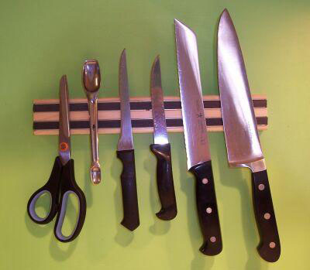
Leadership Metaphor
Leadership is Like a Knife:
You have to stay sharp.
You have to make cuts.
You spend a good part of the day just hanging around.

Slide 5
My Leadership in Action
Support
Facilitation
Delegation
Gratitude
High Standards
Shared Responsibility
Shared Success

Slide 6
Leadership Task to be Accomplished
My leadership goal is to make the transition from teacher leader to building level administrator.
I look forward to helping students and other educators find success in their scholarly pursuits.

Slide 7
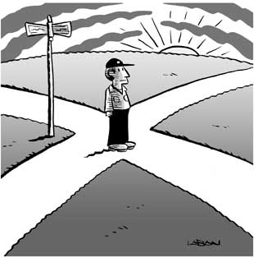
Inspirational Poem
The Road Not Taken
by Robert Frost
Two roads diverged in a yellow wood, And sorry I could not travel both And be one traveler, long I stood And looked down one as far as I could To where it bent in the undergrowth; Then took the other, as just as fair, And having perhaps the better claim, Because it was grassy and wanted wear; Though as for that the passing there Had worn them really about the same, And both that morning equally lay In leaves no step had trodden black. Oh, I kept the first for another day! Yet knowing how way leads on to way, I doubted if I should ever come back. I shall be telling this with a sigh Somewhere ages and ages hence: Two roads diverged in a wood, and I- I took the one less traveled by, And that has made all the difference.

Slide 8
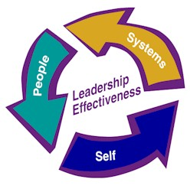
Leadership Model
1. Self
2. Others
3. Organization

